Slide 1

HR ANALYTICS DASHBOARD
Prepared By : Aishwarya Pawar
Tool Used : Tableau
Date : October 2025

Slide 2
Problem Statement :
“The purpose of this dashboard is to analyze employee data and identify patterns in attrition so HR can take action to improve employee retention.”
The company wants to understand why employees are leaving and which departments or groups are most affected. The goal is to analyze attrition and identify areas that need improvement.

Slide 3
Get Data :
Dataset Name : HR Analystics Dataset
Source : Public Dataset Kaggle
Data Used :
The data included basic employee information such as:
Employee ID
Age
Gender
Department
Education Field
Job Role
Job Satisfaction
Attrition (Yes/No)

Slide 4
Suggested Visuals :
KPI Cards : Employee count, attrition count, attrition rate, active employees, average age
Pie Chart : Department-wise attrition
Bar Chart : Education field-wise attrition
Histogram : Age distribution
Matrix : Job satisfaction by job role
Donut Charts : Gender-wise and age-group-wise attrition
Education Slicer : Used to filter the dashboard by different education fields.
Key Measures (Calculated Logic) :
Attrition Count : IF[Attrition]="Yes"THEN 1 ELSE 0 END
Attrition Rate : SUM([Attrition count])/SUM([Employee Count])
Active Employee : SUM([Employee Count])-SUM([Attrition count])

Slide 5
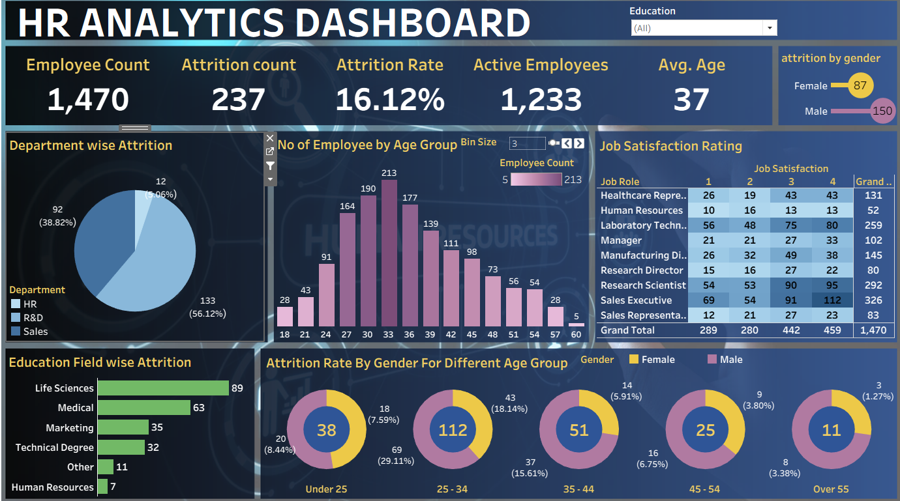
Dashboard :

Slide 6
Key Insights Of Dashboard:
Attrition rate is moderate and needs attention.
R&D and Sales departments have the highest attrition.
Most employees are in the 28–35 age group.
Male attrition is higher than female.
Some job roles show low job satisfaction.
Conclusion :
“The dashboard helps us clearly see where attrition is high and which employee groups need attention. By focusing on these areas, the company can improve job satisfaction and reduce employee turnover.”

Slide 7
THANK YOU

